Slide 1
Protein targeting
By
Ram Balak Mahto
Guest faculty
Zoology department
V.S.J College Rajnagar Madhubani
B.Sc 2nd yr gen/sub

Slide 2


Protein targeting
The proteins synthesized on ribosomes have different destinations such as:
Mitochondria
Lysosomes
Nucleus
Cell membrane
Export from the cell

Slide 3










The signal that directs the protein to its destination is inbuilt in the protein molecule
This signal is like an address written on the protein molecule

Slide 4

Addition of mannose-6-phosphate to a protein directs it to lysosomes
If mannose-6-phosphate is not added, lysosomal enzymes fail to reach the lysosomes
This results in inclusion cell disease

Slide 5

Signal hypothesis
Gunter Blobel showed how proteins are exported from the cell
He proposed the signal hypothesis which is now proven

Slide 6

Presence of signal sequence directs the protein to cell membrane or export outside the cell
Signal sequence is also known as leader peptide or signal peptide
It is a sequence of 15-30 amino acids at the N-terminus of the protein

Slide 7

When signal sequence emerges from the ribosome, it is recognized by signal recognition particle
Signal recognition particle (SRP) is a complex of 7S RNA and six polypeptides
SRP binds the signal sequence

Slide 8

SRP also binds to SRP receptor on the endoplasmic reticulum (ER)
SRP receptor is also known as the docking protein
It is present on the external side of ER

Slide 9

The ribosome synthesizing the protein is bound to a ribosome receptor on ER
Ribosome receptor is present on the external surface of ER
The signal sequence is directed into ER through translocon
Translocon is a protein-conducting channel

Slide 10

The signal sequence is split off by signal peptidase present in ER
The nascent protein is usually glycosyl- ated and transferred to Golgi apparatus
From there, it is either directed to cell membrane or is exported from the cell

Slide 11
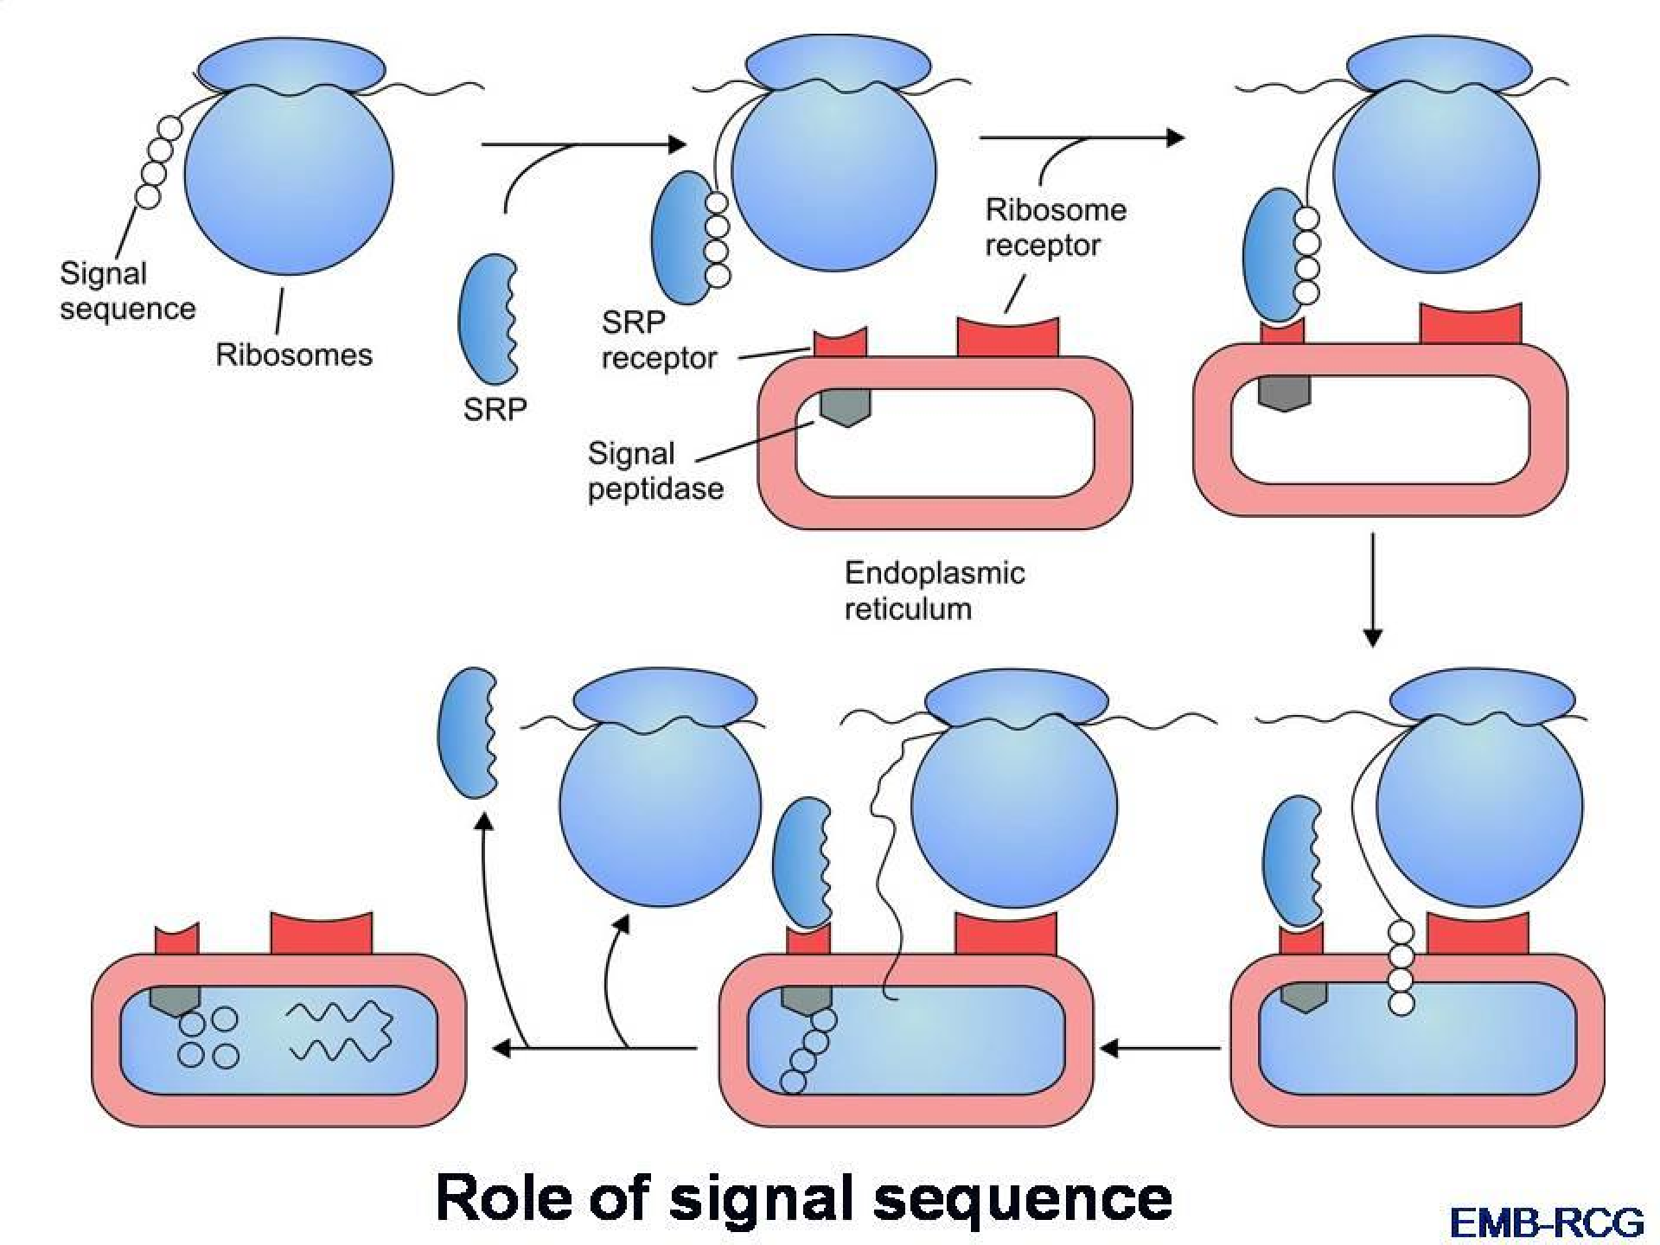



Slide 12




